Slide 1

Systemic Racism
Remarks by Nishan Duraiappah
Chief, Peel Regional Police
September 30, 2020

Slide 2
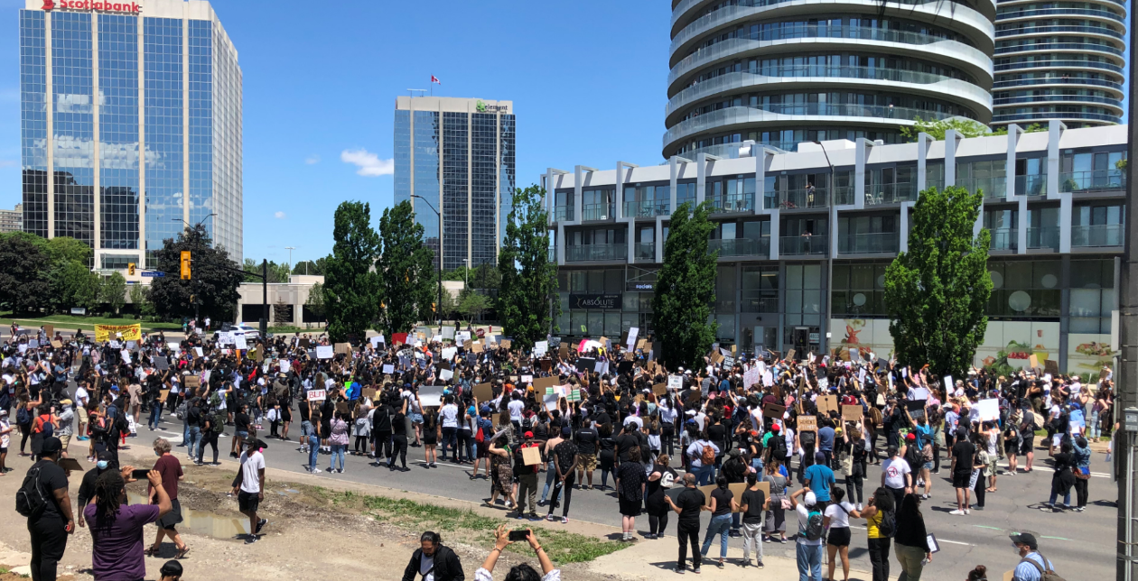
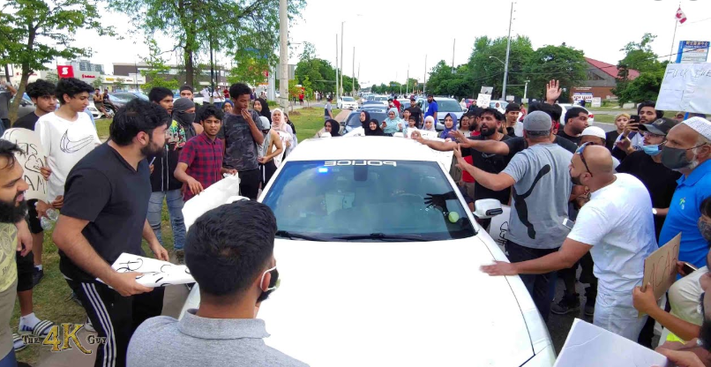
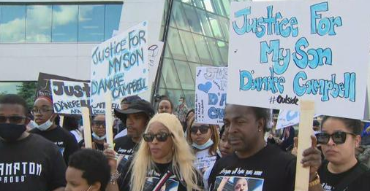
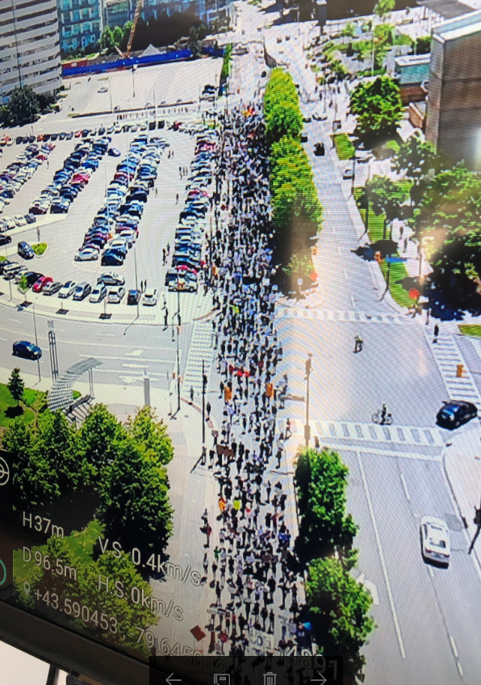
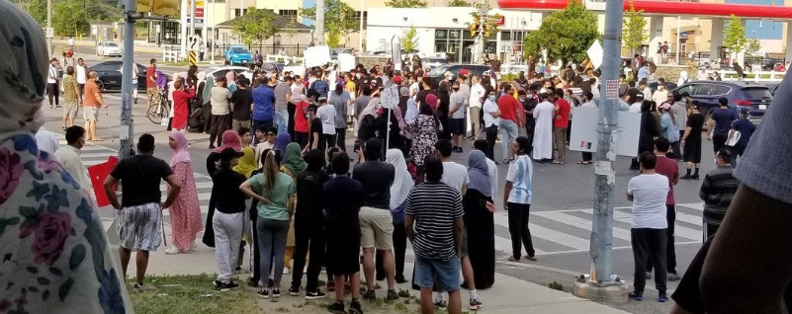
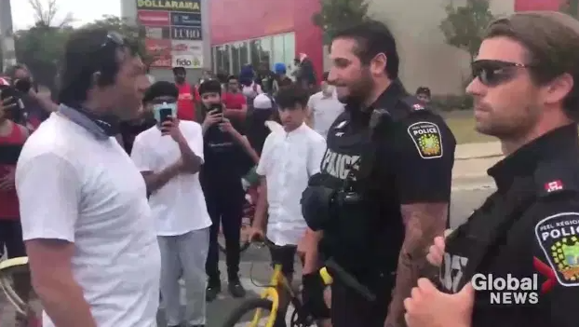
Policing - Systemic Racism

Slide 3

Systemic Racism (SR) Defined
The Government of Ontario defines systemic racism as:
“Organizational culture, policies, directives, practices or procedures that exclude, displace or marginalize some racialized groups or create unfair barriers for them to access valuable benefits and opportunities. This is often the result of institutional biases in organizational culture, policies, directives, practices and procedures that may appear neutral but have the effect of privileging some groups and disadvantaging others.”
Government of Ontario. Data Standards for the Identification and Monitoring of Systemic Racism. Accessed at: https://www.ontario.ca/document/data-standards-identification-and-monitoring-systemic-racism/context

Slide 4
Individual Racism (IR) Defined
Individual Racism refers to an individual's racist assumptions, beliefs or behaviours and is "a form of racial discrimination that stems from conscious and unconscious, personal prejudice" (Henry & Tator, 2006, p. 329). Individual Racism is connected to/learned from broader socio-economic histories and processes and is supported and reinforced by systemic racism.
Alberta Civil Liberties Research Centre

Slide 5
Current Considerations?
Police interactions with racialized community – Use of Force?
Disproportionate contacts with certain communities?
Police processes?
Police interactions with other systems (health, education, housing)
“General Need for Change in Policing” – Police Reform?

Slide 6
Opportunities for Change:
INTERNAL FOCUS: Human Rights Centric Approach
EXTERNAL FOCUS: Community Well-Being

Slide 7

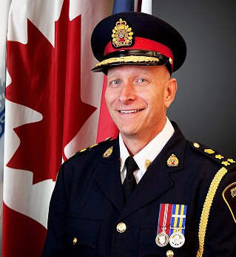
Internal Focus:
Human Rights Centric Approach
“Ontario police services depend on the public’s trust and confidence to effectively serve their communities. It is important that all law enforcement personnel deliver policing services in a fair and respectful manner,” said Chief Paul Pedersen, OACP President. “The OACP is committed to the seven key principles outlined in the OHRC’s Policy as the basis for preventing and addressing racial profiling in law enforcement. The recommendations in the Policy are far-reaching. We look forward to working with the OHRC to address issues related to the recommendations and providing guidance to our organizations.”

Slide 8
What could a Systemic - Human Rights Focus Look like ?
Acknowledgement
Community Engagement
  Revisit and renew your consultative, advisory & engagement models
  New stakeholder
Policy Guidance
  Conduct a policy review and update
  Reflect principles & human rights best practices
    Training: external experts, scenario, empathy-based, connected to policies, involvement of racialized communities
    Use of Force
    School Protocols
    Technology
    Performance Management
Data Collection
  Collect disaggregated data
  Analysis & reporting
Monitoring and Accountability
  Body Worn
  Early Intervention System (EIS)
  Chief reporting
Organizational Change & Sustainability

Slide 9
2. External Focus:
COMMUNITY SAFETY & WELL-BEING - FRAMEWORK
INCIDENT RESPONSE
Critical and Non-Critical Incident Response
SOCIAL DEVELOPMENT
Promoting and Maintaining Safety and Well-being
RISK INTERVENTION
Mitigating Situations of Elevated Risk
PREVENTION
Proactively Reducing Identified Risks
Notes:
New legislative requirements under the current Police Services Act (1990) mandates municipal councils to prepare and adopt a Community Safety and Well-Being plan, initially due by January 1, 2021. The deadline has been extended due to the pandemic, although a new date as not been announced.
The Ministry of the Solicitor General has developed the Community Safety & Well-Being Framework to guide communities. The Framework focuses on keeping a community safe through:
Incident Response
Risk Intervention
Prevention
Social Development
Region of Peel Community Safety & Well-Being System Leadership Group - A System Leadership Table has been established that will act as an advisory group to inform the development of the plan. PRP is also represented on this committee.
As mentioned, our new Organizational Structure will place emphasis on Community Safety & Well-Being, along with Innovation and Technology and Community Policing Operations.

Slide 10
Combined: “Systemic Change” Roadmap
Community
Engagement
EDI
Strategy
Human Rights
HR/Culture Leadership
Community Safety & Well-Being Strategies
Technology
Innovation
Human Rights Centric
Acknowledgement
Engagement
Policy Guidance
Data Collection
Monitoring and Accountability
Organizational Change
Multi-Year Action Plan

