Slide 1


Session 4: Developing Basic Constable Competencies – a Case Study
Hosted by: Competencies Sub-committee
Chair: Steve Schnitzer, JIBC Co-Chair: Marc Desaulniers, ENPQ
Date: October 1, 2020

Slide 2
Meet the Competency Sub-committee
Chair: Steve Schnitzer, JIBC
CPKN staff rep: Sandy Sweet
Committee Members:
Darla Blackmore, Calgary Police Service
Chuck Byham, York Regional Police Service
Stacey Moreau, Canadian Police College
Matthew Swarney, Motorola Solutions
Interested in joining or working on one of our projects? Let us know!
Notes:
Nationally representative, others asked to join as required, meet 4 times/yr to review courses/projects (1 hr each).

Slide 3

Mandate
The Competencies Sub-Committee will support CPKN’s mission to deliver high quality technology-enhanced professional development that meets the evolving needs of Canadian police by advancing efforts that enhance the professionalism of the policing sector.

Slide 4
Initiatives
Plan a session for the annual Stanhope Conference
Works to modernize the competency framework to align learning and development with performance
Supports advances in consistent approaches to curriculum, course and instructional development
Partners with post-secondary institutions to offer accredited courses
Facilitates the integration of research and evaluation into learning solutions, leveraging strategic partner organizations as well as the Network

Slide 5
NAC Competency Sub-Committee Projects
2020
2021
Develop Terms of Reference
Launch of the Community of Practice for access to the PSC CBMF
Promote work on Leadership Competencies
Identify future projects and activities including:
  Upcoming project on Digital Competencies
Digital Competencies
Support to the National Steering Committee through:
  Helping to develop and submit applications for funding
  Promote the full adoption of Community of Practice as source of PSC CBMF

Slide 6
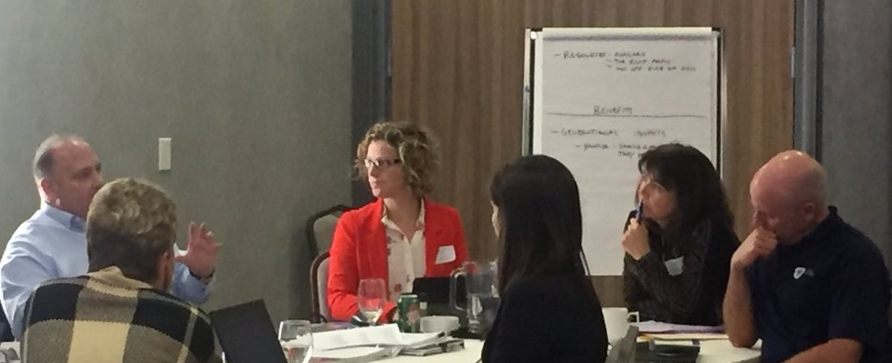
Quick History
CBMF created by Police Sector Council – 2007-2013
CPKN became custodian in 2015
Workshop hosted November 2018
MPLC project in 2020

Slide 7

National Steering Committee (NSC)
Kimberley Greenwood, Barrie Police Service & CACP
Tom Stamatakis, CPA
Micki Ruth, CAPG
Serge Côté, Canadian Police College & CACP-HRL
Andy McGrogan, Medicine Hat Police Service
Steve Bell, Ottawa Police Service & OACP
Jennifer Richens, RCMP
Steve Schnitzer, JIBC
Marc Desaulniers, ENPQ

Slide 8
NSC Terms of Reference
Be national champions for the competency framework
Direct and oversee initiatives related to the competency framework
Advocate for Competency-based Management (CBM) on the local, regional, provincial and national levels
Seek funding to enable CBM initiatives to move forward

Slide 9
Action Plan for CBM
Finalize the Terms of Reference for the Steering Committee (SC)
Finalize white paper targeted to Public Safety Canada, F/P/T Ministers /DMs/ ADM’s
Reach out to PSC to gauge their interest in this initiative
Develop budgets to support the SC’s plan
Engage potential sources of funding to support the initiatives below. Besides PSC, what other sources could be explored?
Engage CPKN’s National Advisory Committee’s sub-committee on competencies to be the working group for this SC

Slide 10

Recent Activity
White Paper released August 2020
Community of Practice Created August 2020
Public Safety Canada Contacted for Next Steps

Slide 11
Developing Basic Constable Competencies:
A Case Study

Slide 12
Meet the Speakers
Angela Ripley, Ph.D., Industrial/Organizational Psychologist & Education Consultant
Dr. Angela Ripley is an education consultant and an I/O Psychologist. Angela’s experience has included reviewing and providing recommendations on police selection and police training effectiveness. Projects have included a review of the Justice Institute of British Columbia Police Academy and the Investigator Certification Program of the British Columbia Independent Investigations Office (IIO). Angela is currently working with CPKN to create a National Police training inventory on training relating to police community interaction, the Delta Police Department reviewing the effectiveness of the newly acquired Vitra Simulator, and JIBC to implement recommendations into the JIBC Police Academy.

