Slide 1
Pivot to Virtual Learning: The JIBC Experience
Shelley Tiffin, Instructional Designer
Stanhope 2020
Notes:
Thank-you
Betty for inviting me to the panel for an opportunity to share our experience
the JIBC team who pulled together to make it happen in a very short timeframe

Slide 2
Overview
Intro to the Police Academy
Short / Long term strategies to pivot to virtual learning
Challenges identified and addressed
Notes:
Session Three: COVID-19 and the Pivot to Virtual Learning
In this session, we will explore how police training units responded to COVID19 and turned training challenges into opportunities. What strategies were employed to quickly pivot training to virtual spaces? How were challenges addressed?
I want to first speak about our pre-COVID experience with online learning, and how we leveraged that to our shift to virtual classroom

Slide 3

Introduction: Police Academy
Recruit Training for 13 BC police departments
Academic setting (JIBC)
Institute’s online platform (Blackboard):
Notes:
Seconded instructors bring up to date experiences
Sessional instructors bring experience and confidence in active learning teaching skills
Wide range of computer literacy, but very willing to learn

Slide 4
Recruit Training Program Structure
Block I
13 weeks
Police Academy
Block II
18 weeks
Field Training in Home Department
Block III
8 weeks
Police Academy
Block IV
1 year
Home Department
Recruit Constable
Qualified Municipal Constable
Certified Municipal Constable
Notes:
New recruit training to build foundational knowledge during multi-week training
pre-COVID: both asynchronous and synchronous online use of content in Blackboard:
Asynchronous:
Pre-read, quizzes,
discussion boards,
Articulate Storyline modules with knowledge checks, and
CPKN courses
Synchronous: aka ‘laptop campus’:
access content for case studies;
in PRAXIS for investigation simulations

Slide 5
Short-term Strategies
Block I classes ‘in progress’:
Prioritize qualifications needed in Block II
fitness, firearms, and driving
Communication plan
Shift as much as possible to online
Two Block III classes ‘starting soon’:
14 day ‘self-isolate’ and entirely online
Notes:
As businesses were tasked with creating COVID19 mitigation strategies, schools were exploring online delivery to reduce risk of exposure and to enhance safety. Guided by public health and WorkSafeBC protocols to ‘flatten the curve’ and reduce transmission for the safety of the recruits and all concerned; JIBC mitigation Plan.
COVID shift from f2f classroom to virtual classroom
BI: We increased our use of Blackboard tools such as the ‘Discussion Board’ – ‘texting’ for synchronous communication. Wasn’t ideal, but it worked.
JIBC quickly completed a privacy impact analysis - PIA and purchase to make Collaborate Ultra available to us.
BIII: We moved case studies (normally distributed thru Block II) into the first two weeks in Collaborate

Slide 6

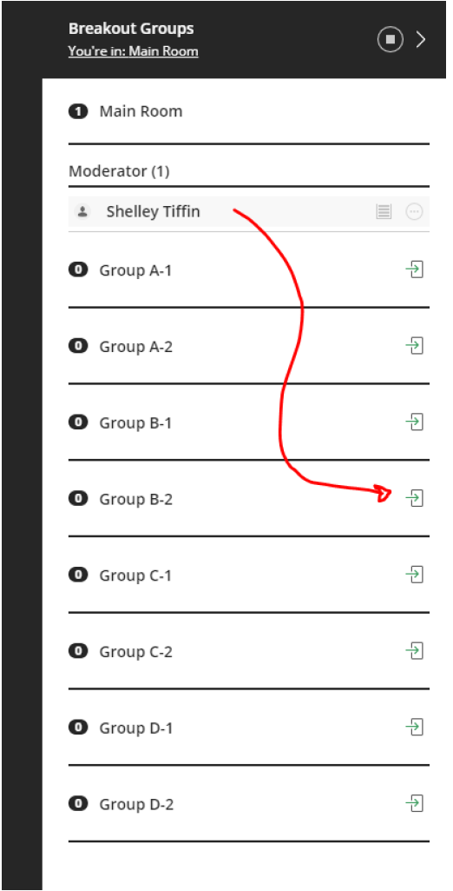
virtual classroom
Notes:
PRE – CLASS activity:
Complete pre-reading and knowledge checks independently, in Blackboard
CLASS activity:
In a F2F case studies classroom – 6 recruits seated around a table, log into Blackboard to read and discuss resources for a tabletop exercise. Instructors circulate to ensure everyone is on track.
In Collaborate virtual classroom – 6 recruits go into a breakout room, and access Blackboard for the same resources. Instructors visit each breakout to ensure everyone is on track.
POST – CLASS action:
Apply learning in practical's, scenarios, exams, etc.
We retained the curriculum design -- learning goals and outcomes; just changed the tool.

Slide 7
Long-term Strategies
Moving forward with future classes:
Select lessons suitable for virtual classroom
Modify lesson plans
Prepare Instructors
Learn from experience:
Re-implement F2F where feasible and meeting COVID19 mitigation plan
Notes:
Collaborate for Online learning, currently approx. 20% or one day per week
online mentor meetings,
Some recruit training must be face to face.

Slide 8
Challenges
Time pressure
Instructor preparedness
Balance risk of exposure, with F2F active learning program design
Reduced F2F = reduced opportunities
modelling behaviours e.g. conduct, deportment
correcting behaviours e.g. discipline
Notes:
Time:
COVID19 is unprecedented – everyone was under time pressures to act
Do not rush the PIA – get it done right and by someone who knows what they are doing
Ensure equal access to technology – Connectivity issues / bandwidth issues and FIREWALLS
Instructors:
Some instructors adapted quickly and others required more time.
Some went rogue and used ZOOM had to be pulled back
All instructors prefer F2F, AND resilient! Will likely continue to supplement F2F with a virtual classroom to enhance recruit success.
Balancing risks:
Ongoing communication, guided by science,
Reduced opportunity for behaviour checks
Put an increased focus on behaviour checks in the 80% f2f

Slide 9
Summary
Instructor & recruit ‘Buy-in’
20% recruit training in virtual classroom
90+ grads
Notes:
Buy in
‘Collaborate is equally effective, and in some situations better than in class’.
‘Recruits are much more involved in discussions than with F2F.’ An unexpected Positive outcome.
‘Blackboard Discussion Board is an excellent way to compile ideas from recruits’.
Of the two weeks ‘self isolate on Collaborate: it was a great learning environment - brought our small group (x6) together because we had to figure things out for ourselves.’
Instructors prefer F2F, but have been encouraged by the virtual classroom option and will probably continue to use online to enhance their f2f teaching in a post COVIDF world.

