Slide 1

Session 5: Axon Virtual Training & 360 Training
Hoseted By: CPKN Innovation and Learning Subcommittee
Chair: Betty Freose, Vancouver Police Department
Co-Chair: Sean O’Brien, Toronto Police Service
Moderator: Randy Cameron, CPKN
October 1, 2020

Slide 2

The OPVTA is a non-profit means of providing professional, cost-effective in-service training to Ontario’s law enforcement community. Formed in 1996, our audience has grown to over 27,000 police officers, representing over 85 agencies in Ontario and beyond.
All OPVTA programs are produced by the members of the Niagara Regional Police Service Video Unit, whose body of work has resulted in international recognition and nearly 200 awards for production excellence since 1982.

Slide 3
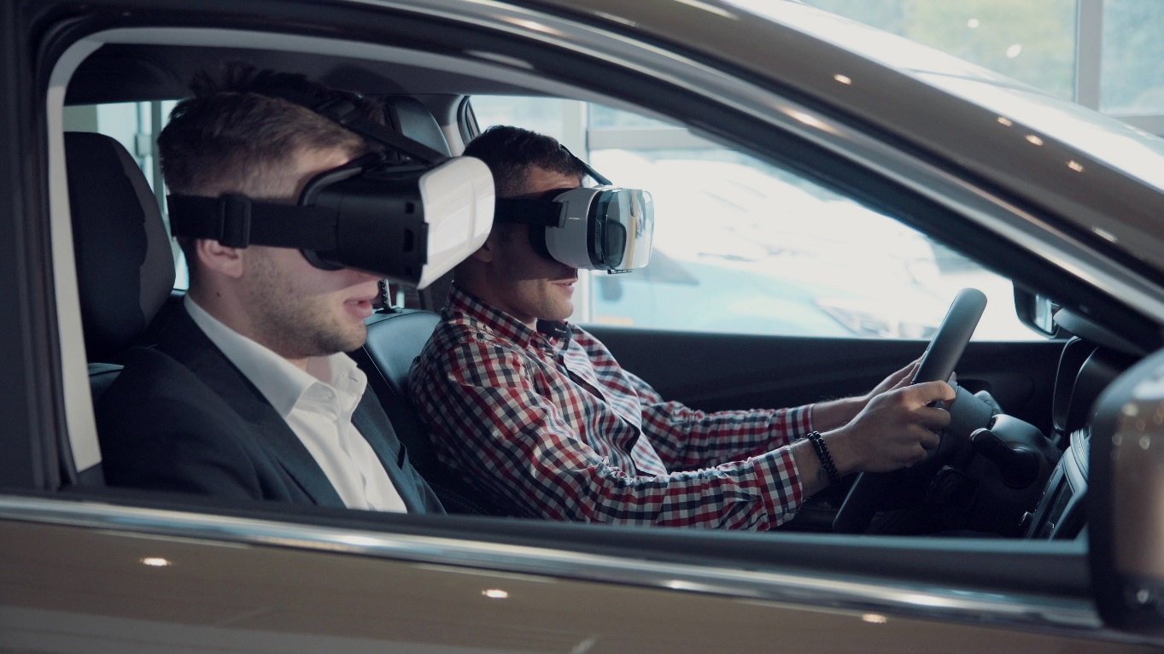
360 vs. VR
360 and VR are actually two separate experiences.
When watching a 360 video, the viewer can move either left to right or top to bottom within an enclosed spherical space. On the other hand, a virtual reality experience can almost seem limitless.
Think of it like this — with 360 videos, you’re in the passenger seat of a car. The driver represents the filmmaker, who creates a stunning experience and invites you along from the ride. You can look around from your seat and enjoy the curated scenery. With VR, you are behind the wheel, deciding where you want to go.

Slide 4



360 vs. 3D
360° video is video that’s filmed in 360 degrees, but with no depth of field.
3D video gives you depth of field. To consume 3D video, you will need a 3D headset and a good cellphone. The experience is similar to what you’re used to at the 3D movie theatres.
360 allows the viewer to look around.
3D allows the viewer to see objects in 3D with distance, but the field of view is fixed. !80 3D allows you to look around in 180 degrees and also has depth perception or 3D.

Slide 5
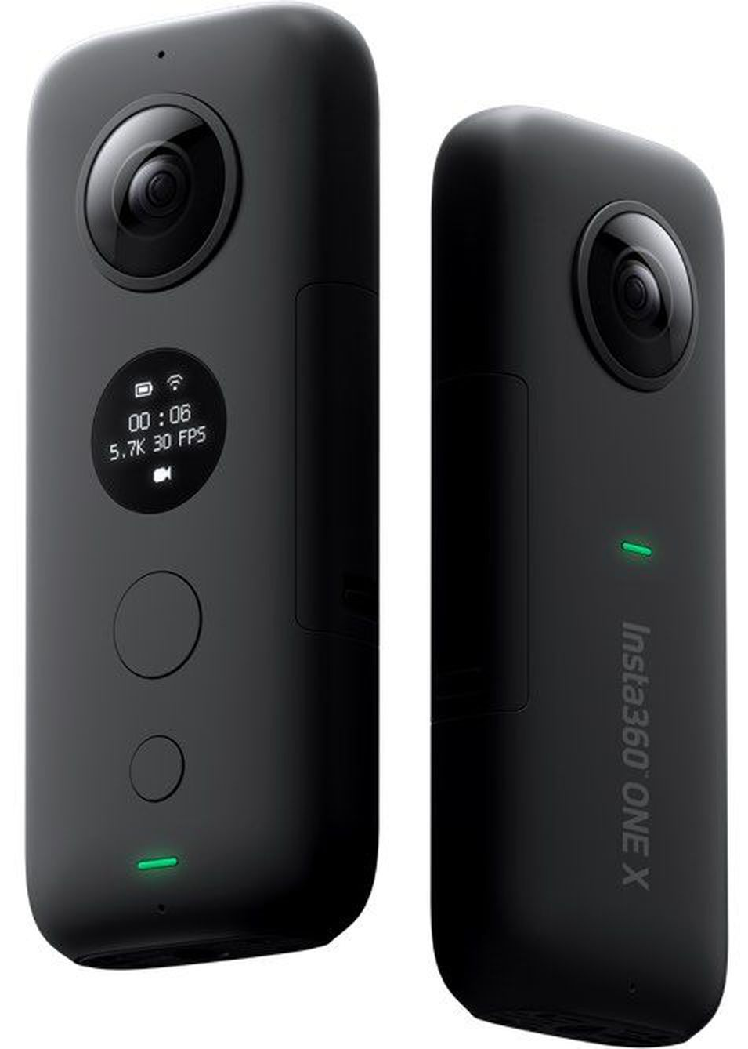
Hardware Insta360 One X
Video resolution: 5760*2880@30fps, 5760*2880@25fps, 5760*2880@24fps, 3840*1920@50fps, 3840*1920@30fps, 3008*1504@100fps
Photo format: insp, jpeg(can be exported via App), RAW(dng) (RAW files require software on PC/Mac to stitch.)
Video format: insv, mp4(can be exported via App), LOG
Video coding: H264
Video Bitrate: Up to 120Mbps
Stabilization: Built-in 6-axis gyroscopic stabilization

Slide 6
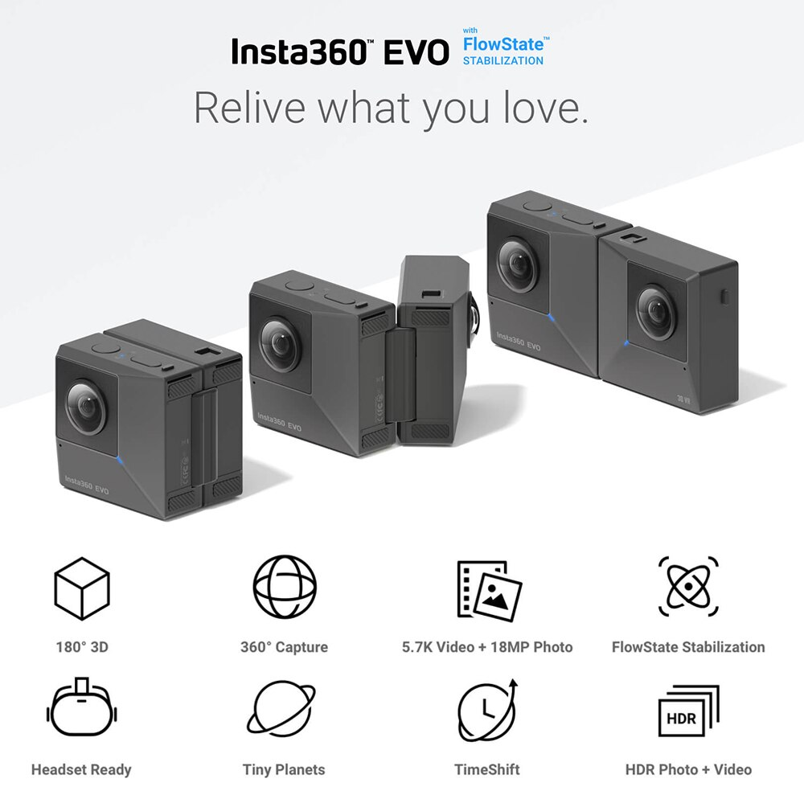
Hardware Insta360 Evo
Photo resolution: 6080*3040 (18 MP)
Video resolution: 5760*2880@30fps，3840*1920@50fps，3840*1920@30fps，3008*1504@100fps
Photo format: insp, jpeg (can be exported via App), dng (RAW) (RAW files require software on PC/Mac to stitch.)
Video format: insv, mp4 (can be exported via App), LOG (LOG files require software on PC/Mac to stitch.)
Video coding: H264
Video bitrate: Up to 100Mbps
Stabilization: Built-in 6-axis gyroscopic stabilization
Compatible devices: iPhone XS, iPhone XS Max, iPhone XR, iPhone X, iPhone 8/8 Plus, iPhone 7/7 Plus, iPhone 6s/6s Plus, iPhone SE, iPad Pro, iPad (2018)

Slide 7
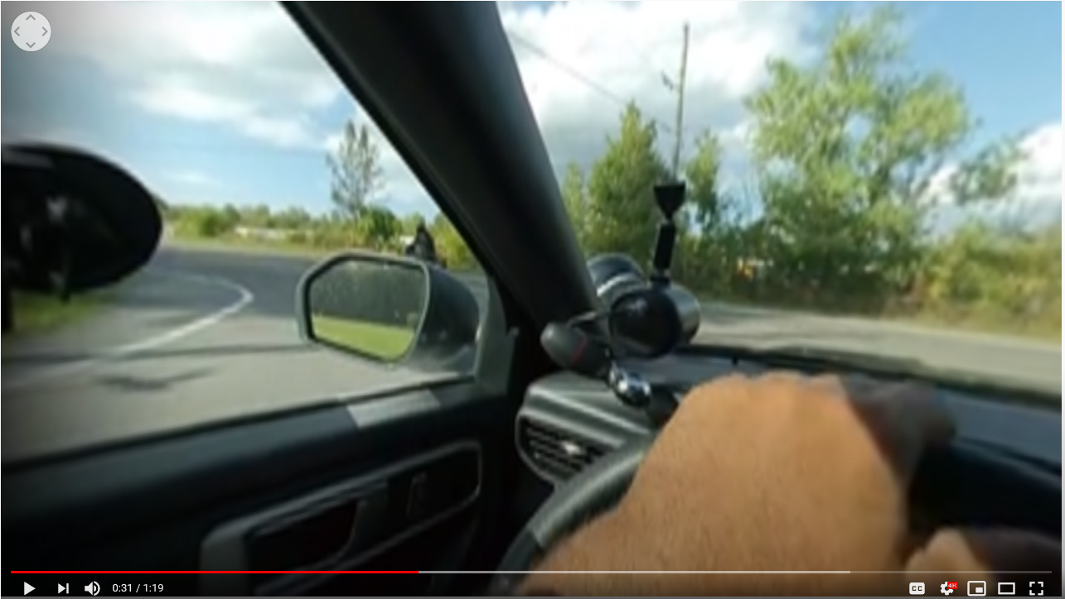

Demo
https://www.youtube.com/watch?v=LVZcvuq4VHQ

Slide 8
Q&A

Slide 9
Thank you

