Slide 1
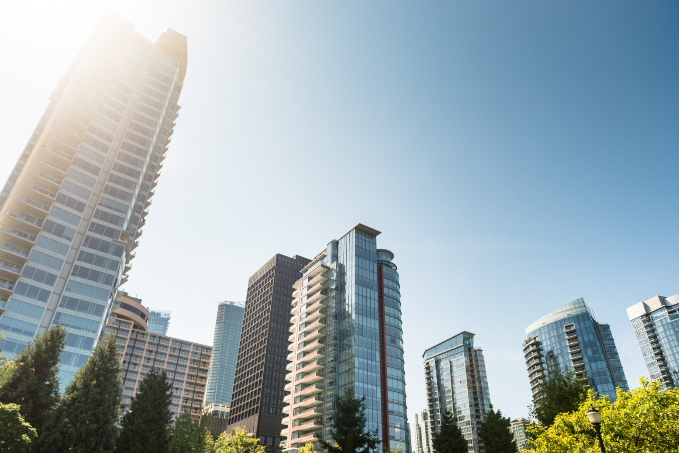

COVID-19 and the Impacts on Virtual Learning
Vancouver Police Department| 2020

Slide 2

Pandemic Challenges we were Facing in March
No in-person classroom-based skills training
Reduced travel to office
Need to assess our course offering and set priorities
All other in-service training was cancelled

Slide 3


Recognizing Existing Technology
Use primarily as teleconferencing tool
CPKN Learning Management System
Upload learning resources
Cisco WebEx
Already implemented
Accessible to internal and external users

Slide 4
Implementation of Virtual Learning
Recruit Development Program
Phase I
Critical Incident Manager Course
Phase II
Special Municipal Constable Program
Phase III

Slide 5
Implementation of Virtual Learning
Recruit Development Program (April 14-16th)
  Class of 20 learners
  No group activities
  WebEx tutorial sessions for facilitators and learners
  Web/teleconference etiquette
Phase I

Slide 6
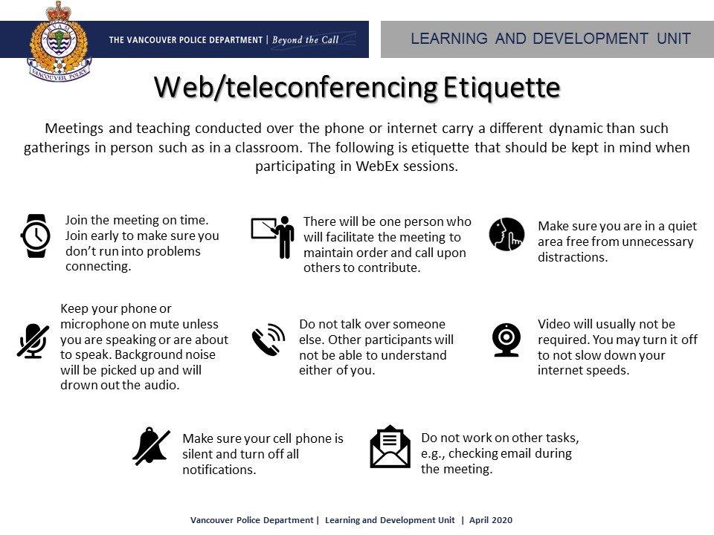

Slide 7
Implementation of Virtual Learning
Critical Incident Manager Course (April 26 - May 1st)
Class of 6 learners
Scenario-based learning
WebEx tutorial sessions for facilitators and learners
Web/teleconference etiquette
Scenario discussion/debriefs
Blended-learning
Phase II

Slide 8
Implementation of Virtual Learning
Special Municipal Constable Program (May 4th – Sept 25th)
Class of 20 learners
Lots of group activities
Limitations of WebEx
WebEx Training
WebEx Training tutorial sessions for facilitators and learners
Web/teleconference etiquette
Phase III

Slide 9
Setting Everyone up for Success
Curriculum Audit
Curriculum Updates
Tutorial sessions
Virtual learning methodology map
Teaching Strategies

Slide 10
Challenges with Transitions
Lesson specific challenges
Limitations on immediate feedback
Personal teaching preferences
Buy-in
Devices
Lesson specific challenges
Assessment
Multimedia

Slide 11

Looking into the Future
Opportunities for other agencies to attend VPD courses
Resiliency to stricter pandemic restrictions
Opportunity to transition other courses into the virtual environment
Alleviating demands on classroom space booking

Slide 12

Looking into the Future
Renovating the classrooms to expand and allow courses to be accessed on virtually
Mounted web conferencing camera
Phone system with wireless microphones
New television set-up

Slide 13
Questions?

