Slide 1

Sound Times Support Services
Using the opportunity of lived experience to provide quality mental health services

Slide 2
History
Divested from a mainstream case management organization and incorporated in 1991
Goal was to create an organization staffed and controlled by user and former users of services
Original mandate was more social/self help focussed
Funding opportunities have allowed us to shift our mandate to the intersection of the Mental Health, Addictions and Criminal Justice systems

Slide 3
Services
Resource Centre
Mental Health and Justice Prevention
Mental Health and Justice Diversion and Court Support
Release from Custody
Addiction/Harm Reduction Services
Psychiatry
Primary Care
Imbedded Legal Clinic

Slide 4
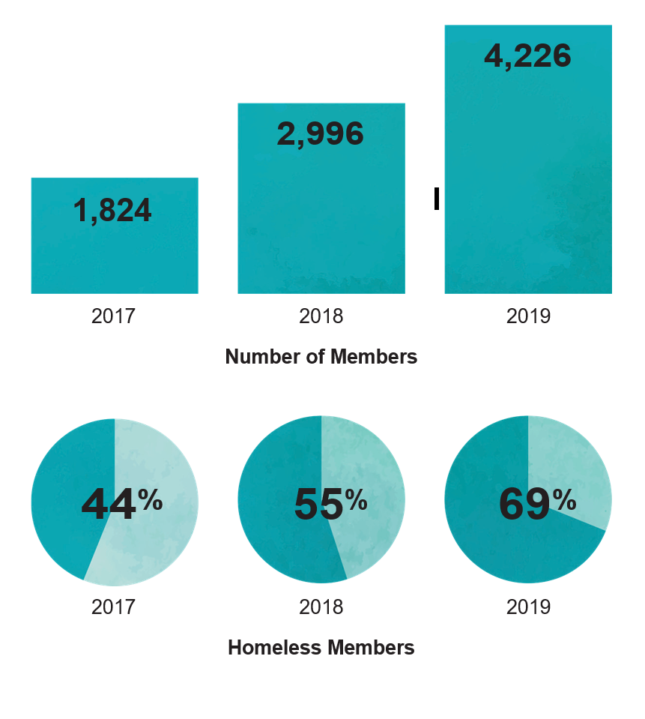
Growth

Slide 5
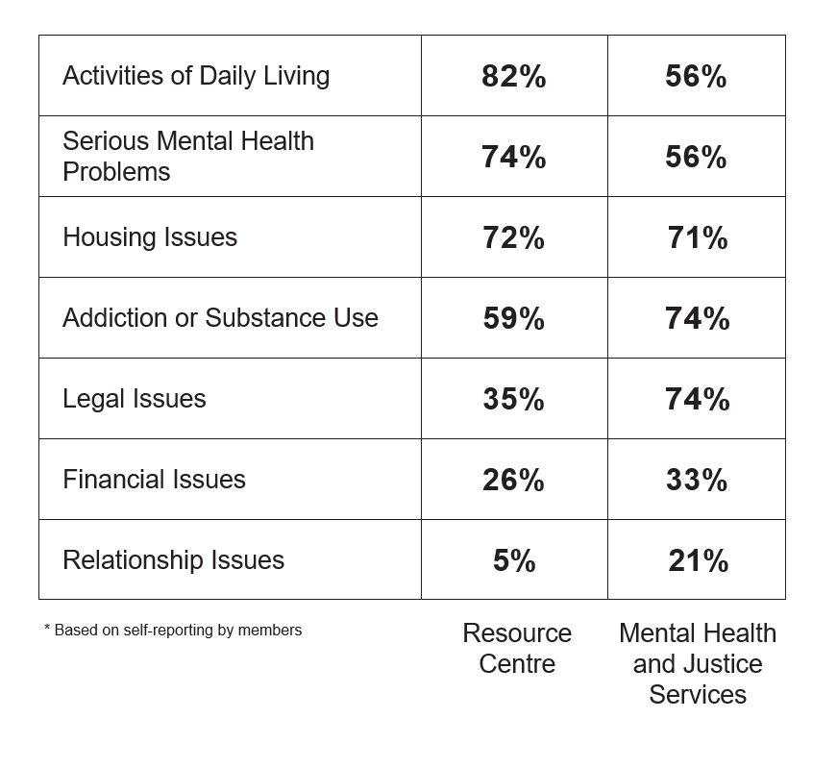
Why do people come?

Slide 6
Provocative Thoughts on Crisis Training
In our own (numerous) consultations on crisis response, no one has ever articulated that they want people to know what it “feels” like to be mentally ill
Many have said that they want people to know what it’s like to be apprehended, either under the Criminal Code, or the Mental Health Act, i.e. how dehumanizing it is to be apprehended by force for having a disability
People see the mental health system as a carceral system – not so different than the criminal justice system, e.g. bail conditions can be just as restrictive as diversion requirements, or Community Treatment Orders/Involuntary Outpatient Committal
While there is much talk about people being the subject of numerous police calls, apprehensions, and the “revolving door” of the justice system, not much is done to address the revolving door of the hospital system. In fact, people with mental illness are the subject of many “ED Diversion” initiatives. Locking the door to help is not help.
In most jurisdictions there is no requirement for organizations involved with an individual to do critical incident reviews after a serious breakdown of supports

Slide 7
A Few More Provocative Thoughts on Crisis
Some crises are the result of numerous failed attempts to access some kind of help with services with which a person is already connected resulting in a “Where were the workers?” questioning by our community
People with mental illness are rarely given the opportunity to speak for themselves on a systemic level, a policy level and in public statements but are instead, represented by well meaning service providers
While some people get meaningful support, on balance, mental health services have mainly failed us. We do not understand why other systems turn to this said same system as “experts”.
There is a big difference between calling 911 for yourself, and having the police called on you. Much of the analysis of “person in crisis” calls does not go far enough into the data to achieve a nuanced understanding of the different kinds of calls and which ones could be diverted from police
There are some real concerns about the call to have “the community” handle crises as most of what is being offered up does not come from people with mental illness, nor does it seem to have a grounding in the statutory framework that governs the rights of people with mental illness.

Slide 8
Where to find us
Like any community that has something in common, people who have used mental health services have organized themselves
We have a long history of advocacy and providing support to each other
From international groups, like World Network of Users and Survivors of Psychiatry who work with the UN to ensure the Convention of the Rights of Disabled Persons are upheld, to local groups that organize themselves around specific issues, run their own organizations, or meet informally for self help

Slide 9
A Framework for Service User Involvement
ACCOMMODATION | Make it the first step, not one subcontracted to MHA organizations | Manage the over-engagement that floods agencies | Reduce the speed of deliberation and discussion to allow time to reflect and discuss
REPRESENTATION | Resource sufficiently to enable uncompromised representation | Enable advocacy without fear | Enable autonomous participation by Service users | Define what 'listened to' means in concrete terms | Widen participation with groups who have no voice or are in other systems | Record what we said and feedback on what was done
FAIRNESS | Understand the impact of ethical issues for SU | Review the ethics of an engagement’s structure and process first | Consider whether participation is really voluntary or coopted | Create definitions that are understandable to Service Users | Use SU engagement metrics & delivery standards to achieve more consistency | Build/use better practices for involvement & engagement
INFORMATION AND KNOWLEDGE | Understand when and how lived experience matters | Cherish & build on previous engagement work & knowledge | Recognize innovative work here and worldwide and spread it | Have $ to research areas important to SU | Know how to analyze/evaluate data from a SU perspective | Build connections with other marginalized communities
CAPACITY BUILDING AND EDUCATION | Clear pathways for information to flow to and from SU | Create climate where ideas are heard and seen | Create Learning Partnerships with other communities | Learn why previous education has or hasn’t worked | Have one body provide SU related training
EQUITY | Enable SU affirmative hiring | Have PSW's play their true role | Employ the unpaid SU working in the system
PROGRESS | Something happens | … and keeps happening

Slide 10

Lana Frado lanafrado@soundtimes.com

