Slide 1






COVID-19
VIRTUALTRAINING
COVID-19
VIRTUALPOLICETRAINING
An Academic & Online Approach
Tom Strancaric, HPS
Joe Countryman, YRP
Jason Siu, YRP

Slide 2


COVID-19
VIRTUALPOLICETRAINING
TIMELINE
2 Weeks
January 6th 2020
24 Recruits go to Ontario Police College
March 30th 2020
Recruits return 1-week early from OPC
April 6th 2020
Recruits receive UoF training and are sent to patrol
June 1st 2020
Decision to host Virtual Week #5 Training
June 15th 2020
VIRTUAL TRAINING
(4 days)
January
February
March
April
May
June
March 17th 2020
Ontario declares
STATE OF EMERGENCY
Hamilton enters
PHASE 2 of Ontario’s
“COVID-19 Restart”
Notes:
https://globalnews.ca/news/6859636/ontario-coronavirus-timeline/

Slide 3

COVID-19
VIRTUALPOLICETRAINING
Training | Normal Training |  | COVID-19 Impact
Ontario Police College | 12-weeks |  | 11-weeks
In-Service Week 1 | CEW/UoF Technology Training Communication Missing Persons CPIC | NARCAN Admin Forensics Physical Training CPKN | Deferred – Assigned to Patrol with Coach Officers. Use of Force, CEW & IRD Training Received
In-Service Week 2 | Traffic Investigations Fitness Pin Mask Fitting Health & Safety | Victim Services IR-100 Physical Training CPKN | Deferred – Assigned to Patrol with Coach Officers.
In-Service Week 3 | IRD X2 Conversion/UoF A.S.D. Qual. Impaired Driving | Courthouse Canadian Hearing Society Divisional tours Physical Training | Deferred – Assigned to Patrol with Coach Officers.
3-Weeks with Coach Officer
In-Service Week 4 | Interviewing & Interrogation MVC Reports Emotional Intelligence Landlord Tenant Act | Major Crime NICHE RMS CPKN Physical Training | Deferred – Assigned to Patrol with Coach Officers.
3-Weeks with Coach Officer
In-Service Week 5 | CIRT Victim Services Sex Assault Unit Officer Involved Collisions Breaching Sudden Death Investigations FAU | Vulnerable Persons Wellness IV Drug Equipment Hate Crimes BEAT and Calls for Service Team Building Intelligence reports NICHE RMS CPKN | Virtual
6-Weeks with Coach Officer | Completed |  | Completed with Coach Officers.
RECRUIT IMPACT
31
In-Service Training Topics
CANCELLED
Notes:
The impact to recruits was severe. Recruits received their mandated Use of Force training and then proceeded to the “road” for Patrol.
Only week 5 was salvaged in a Virtual Classroom delivery.
As you can imagine, the recruits returned from OPC about two weeks after the initial COVID-19 lockdown in Ontario.

Slide 4
COVID-19
VIRTUALPOLICETRAINING
RECRUIT IMPACT
EMOTIONAL
IMPACT
Missed Opportunities, Team Building,
Comradery, Stress of Unknown
Notes:
What about the team building and comradery that would have continued to develop over these weeks? Stress caused by the “unknown”.
New recruits, hitting the road, during a pandemic.
Never “Meet” the presenter

Slide 5
COVID-19
VIRTUALPOLICETRAINING
RECRUIT IMPACT
QUALITY
Quality of presentations/courses and their impact.
Notes:
Example, “Sudden Death Notifications” – although this course was on our list of courses for Week #5 recruits, it was identified that we were having some technical issues with some recruits not being able to log back into the Virtual Classroom platform.
Images in this presentation are gruesome. It was decided that the presentation would not be streamed over the platform, rather Members were provided a PDF to view the document within our secured FirstClass email platform.

Slide 6



COVID-19
VIRTUALPOLICETRAINING
CHALLENGES
TIME
Notes:
Time – Two weeks to plan, implement and deliver 4-days of Virtual Training.
We’ve never done Virtual Training before.

Slide 7

CHALLENGES
2-week self-isolation period before heading to OPC
How do we continue delivering academic training to the recruits who are isolating from home?
Not enough time to revise the curriculum from the ground-up
1
Incoming recruit class of approximately 40 recruits

Slide 8
CHALLENGES
Digital Evidence Management System (DEMS)
How do we deliver in-class computer based training outside a classroom?
2
Deliver in-class computer based training

Slide 9






COVID-19
VIRTUALPOLICETRAINING
CHALLENGES
BigBlueButton
Microsoft Teams
Zoom
Adobe Connect
WebEx
TECHNOLOGY
Notes:
Technology – What platform do we use to deliver? What can our Learners use? What is available on multiple platforms (Windows, Apple, iOS, Android)?

Slide 10

RESULTS
Zoom:
Consultation with Corporate Security
General familiarity
Ease of use
Enough features
Corporate Security owns the main enterprise account, and sources out licenses to members as needed.
Training is currently assigned 5 accounts to manage

Slide 11








COVID-19
VIRTUALPOLICETRAINING
CHALLENGES
DELIVERY
Notes:
Technology – What platform do we use to deliver? What can our Learners use? What is available on multiple platforms (Windows, Apple, iOS, Android)?

Slide 12



COVID-19
VIRTUALPOLICETRAINING
CHALLENGES
SECURITY
Notes:
Security & Confidentiality

Slide 13

COVID-19
VIRTUALPOLICETRAINING
CHALLENGES
LEARNER PRIVACY
&
CONFIDENTIALITY
Notes:
Learner Privacy & Confidentiality – Members working from home required a place that was private, allowed for confidentiality and free from Distraction.
The opportunity to Members to come to the office was available to those who could not create an environment that was free from distraction and private.
One member chose to come into the classroom instead of virtually attending – because they had two children under two at home.
Imagine displaying a “Sudden Death” presentation containing numerous deceased persons, pools of blood and other highly disturbing images and your 8 year old child walks by… what will you be explaining?

Slide 14



COVID-19
VIRTUALPOLICETRAINING
CHALLENGES
PRESENTERS
&
FACILITATORS
Notes:
Technology – What platform do we use to deliver? What can our Learners use? What is available on multiple platforms (Windows, Apple, iOS, Android)?

Slide 15


COVID-19
VIRTUALPOLICETRAINING
CHALLENGES
LEARNER
ENGAGEMENT
Notes:
Learner Privacy & Confidentiality – Members working from home required a place that was private, allowed for confidentiality and free from Distraction.
The opportunity to Members to come to the office was available to those who could not create an environment that was free from distraction and private.
One member chose to come into the classroom instead of virtually attending – because they had two children under two at home.

Slide 16



COVID-19
VIRTUALPOLICETRAINING
CHALLENGES
INFORMATION
DISSEMINATION
Notes:
How do you communicate with Recruits that haven’t received access to, or training for their Internal communications (Tech Training)?

Slide 17

COVID-19
VIRTUALPOLICETRAINING
RESPONSE
Laptop &
Webcam
In-Class
option
Lighting
Snowball
Microphone
Computers for
Moderators
Instructions
Additional
Monitor
Learner
Guide
Modify
Presentations
Notes:
How do you communicate with Recruits that haven’t received access to, or training for their Internal communications (Tech Training)?

Slide 18


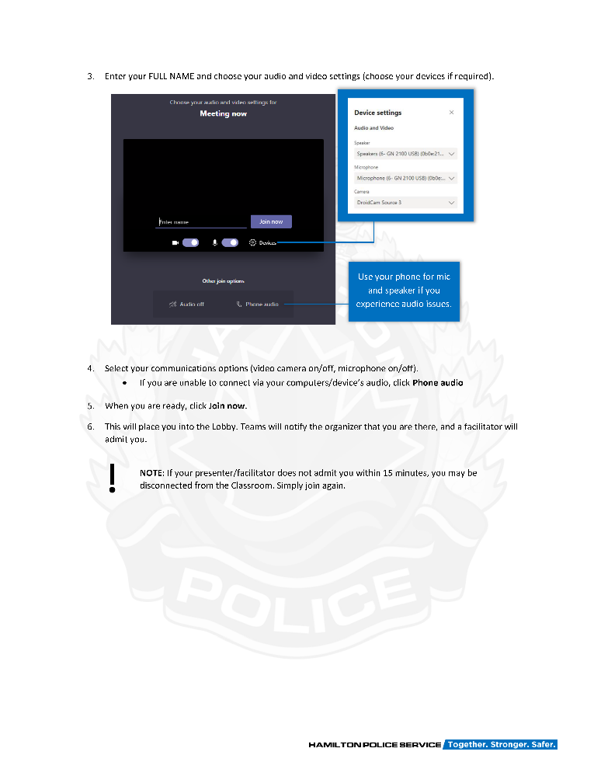
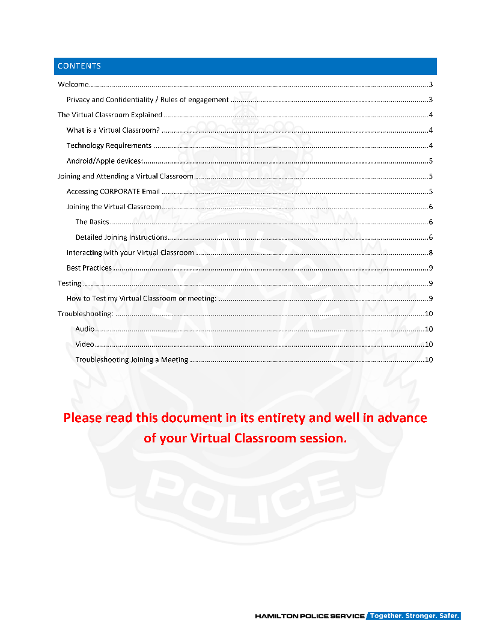
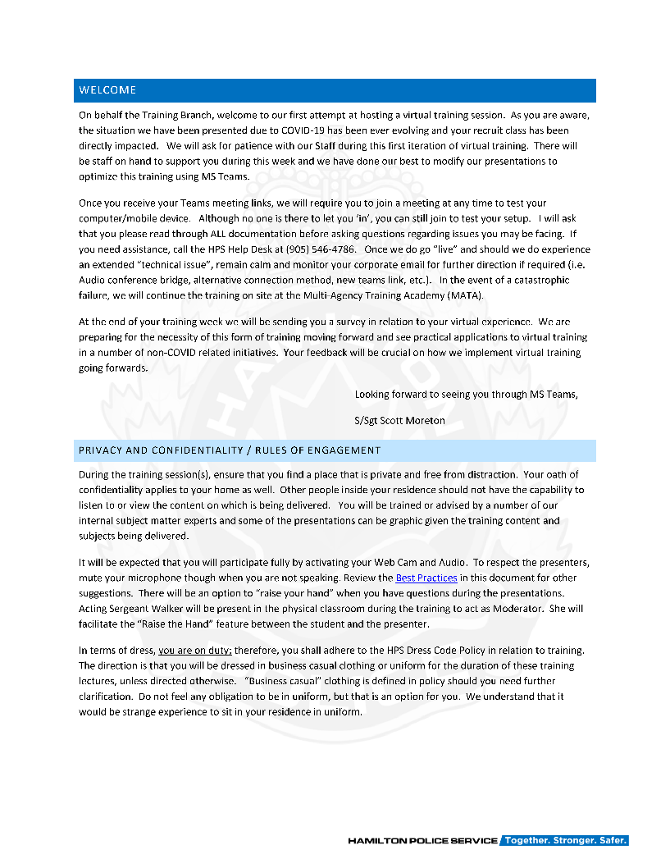
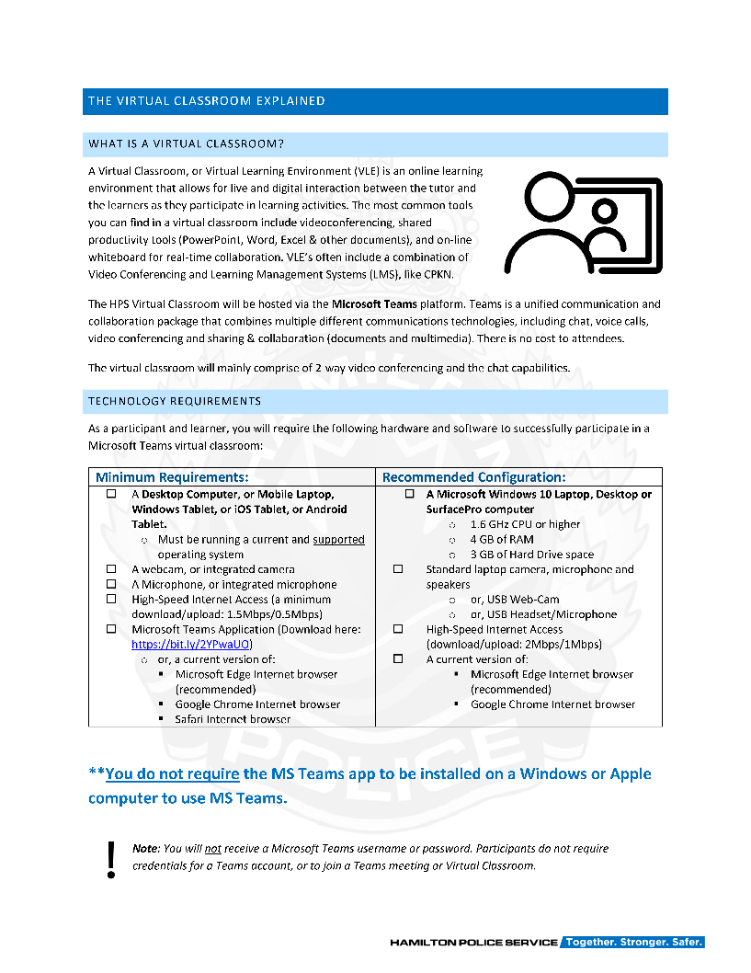
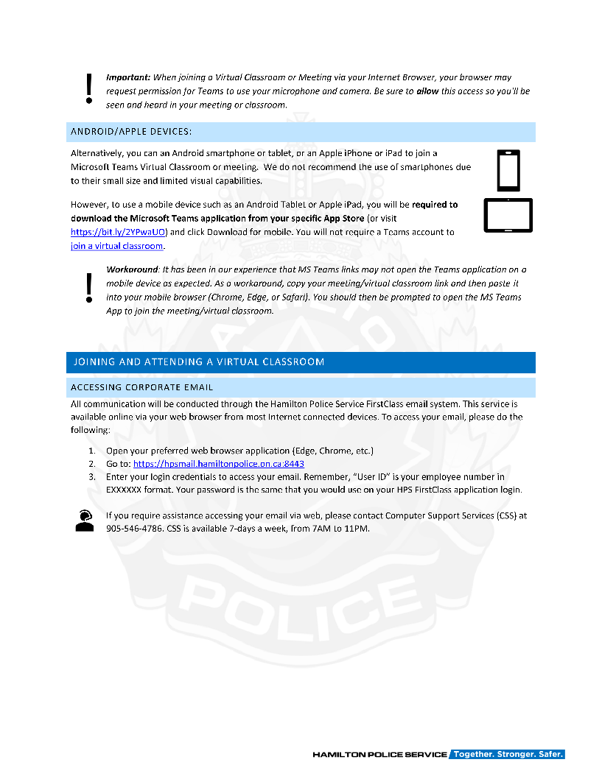
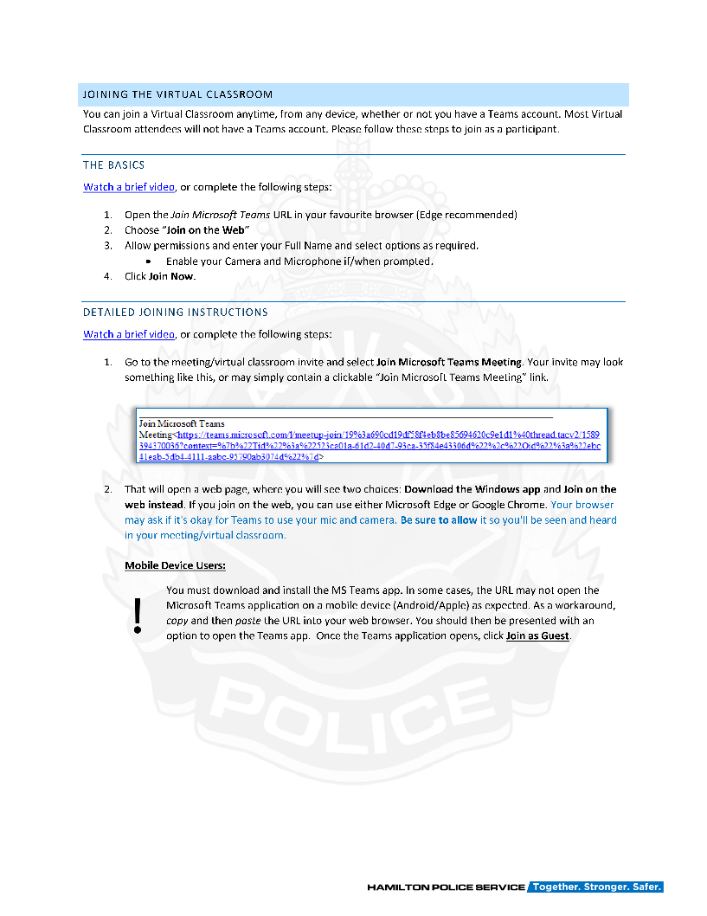
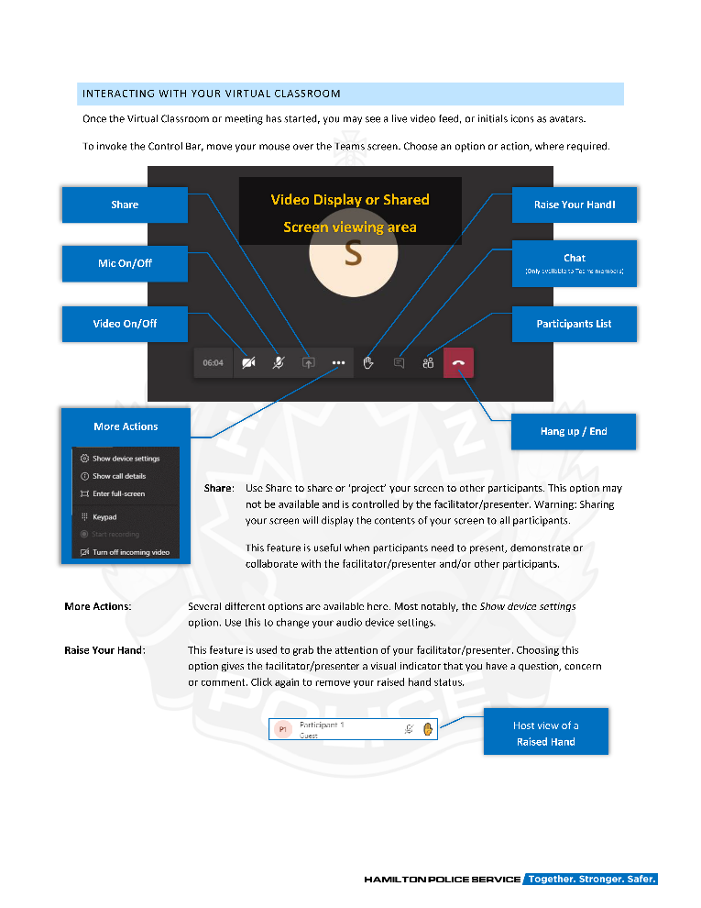
COVID-19
VIRTUALPOLICETRAINING
RESPONSE
Notes:
Created a Virtual Classroom Learners guide.
Included: Rules of Engagement, Privacy & Confidentiality agreements, virtual classroom explainer, technology requirements, accessing email and the Virtual Classroom via MS Teams.
Users were required to sign-on 30 minutes prior to the Training Session.
Learners were provided the opportunity to sign into a test meeting a week earlier for testing purposes.

Slide 19
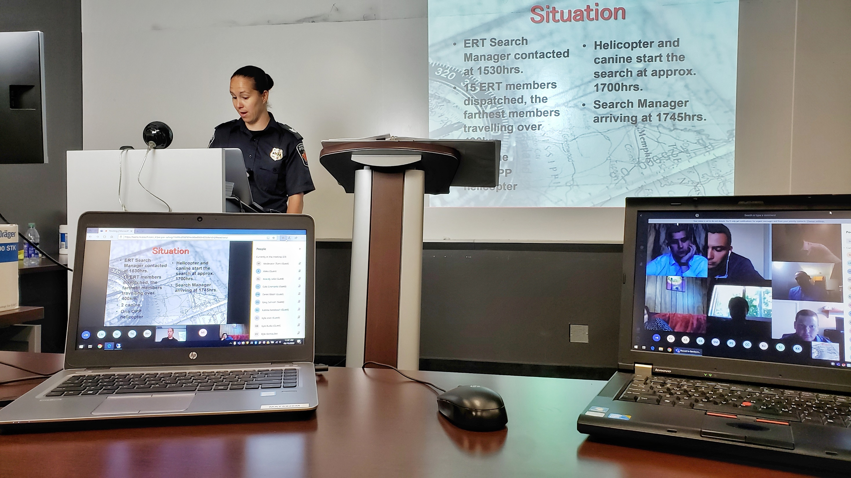
COVID-19
VIRTUALPOLICETRAINING

Slide 20
RESPONSE
Privatize meetings
Standardizing joining instructions
Audio/video setup
Etiquette
Locking rooms
Establishing Instructor and Facilitator roles
Policies and procedures

Slide 21
RESULTS
Recruit Class
(40 students)
1
Curriculum revised for online platform for home-use
2 sessions a day
Optimizing (or removing) videos for playback
Adjust time for breaks
Accommodating for group discussion in virtual breakout rooms
Resources:
Constable acting as a facilitator for these zoom sessions
Tech Support

Slide 22
RESULTS
Hand-off to team of instructors
Replicate in-class experience with instruction and activities
Use virtual classroom tools (screen share, breakout rooms)
Registration process uses existing system and works well
Ongoing DEMS Virtual Classroom Training
2
Notes:
“It’s lovely” - Registrar
Cancellations have been significantly less versus in-class sessions
No booking conflicts with facilities

Slide 23
FEEDBACK
I was able to find an area at my facility to participate in the training that was free of noise and distraction
Notes:
Just over 100 respondents, DEMS, training within YRP facilities, (some at home), mandatory learning.

Slide 24
FEEDBACK
I did not have any technical problems throughout the training
Notes:
Just over 100 respondents

Slide 25
FEEDBACK
I was engaged throughout the program
Notes:
Engaged, but can do better
Instructional techniques
Trainers

Slide 26
FEEDBACK
I would like to participate in more training using Virtual Classrooms
Notes:
Just over 100 respondents

Slide 27
FEEDBACK
What did you like most about learning through Virtual Classrooms?
I was able to do it from alternative locations that fit my schedule.
I found there was not wasted or idle time because the Zoom session is running on clock.
I liked the small break out groups into private side rooms that was utilized - this made the training more personalized.

Slide 28
FEEDBACK
What did you like least about learning through Virtual Classrooms?
I did not enjoy the Virtual Classroom setting at all. I am still surrounded by my work basket and work load, with officers also attending my area requesting assistance with operational needs.
Others who had technical difficulties slowing the rest of the group down.
I've never used Zoom prior to this course. It was overwhelming.

Slide 29
FEEDBACK
Comparison to other training deliveries methods
This training was more effective than typical e-learning modules with no interaction and seems to be a good alternative to delivering training in person.
No comparison, I would take in-class training any day over this virtual method.

Slide 30

COVID-19
VIRTUALPOLICETRAINING
OPPORTUNITIES
Technology Improvements
Notes:
Technology Improvements: Better laptop, better camera, better microphone, better lighting, etc
Using a Video Conferencing application with is more feature rich.

Slide 31
COVID-19
VIRTUALPOLICETRAINING
OPPORTUNITIES
Presenter/Facilitator Support
Notes:
Presenter/Facilitator Support – additional time and resources for Presenters/Facilitators to revamp courseware to fit an online learning environment.
This would include additional training or documentation to support them with the use of additional resources like the LMS, third-party tools and resources, etc.

Slide 32
COVID-19
VIRTUALPOLICETRAINING
OPPORTUNITIES
Remote Presenter/Facilitator
Notes:
Remote Facilitator/Presentation: With technology – we don’t actually need presenters/facilitators in the “room” – rather they can present/facilitate from their own office/environment.

Slide 33
COVID-19
VIRTUALPOLICETRAINING
OPPORTUNITIES
Updates to Curriculum and
Instructional Designs
Notes:
More collaboration type efforts in an online environment. Such as Breakout rooms, group work, forums, reading, interactive modules (storyline), etc.

Slide 34
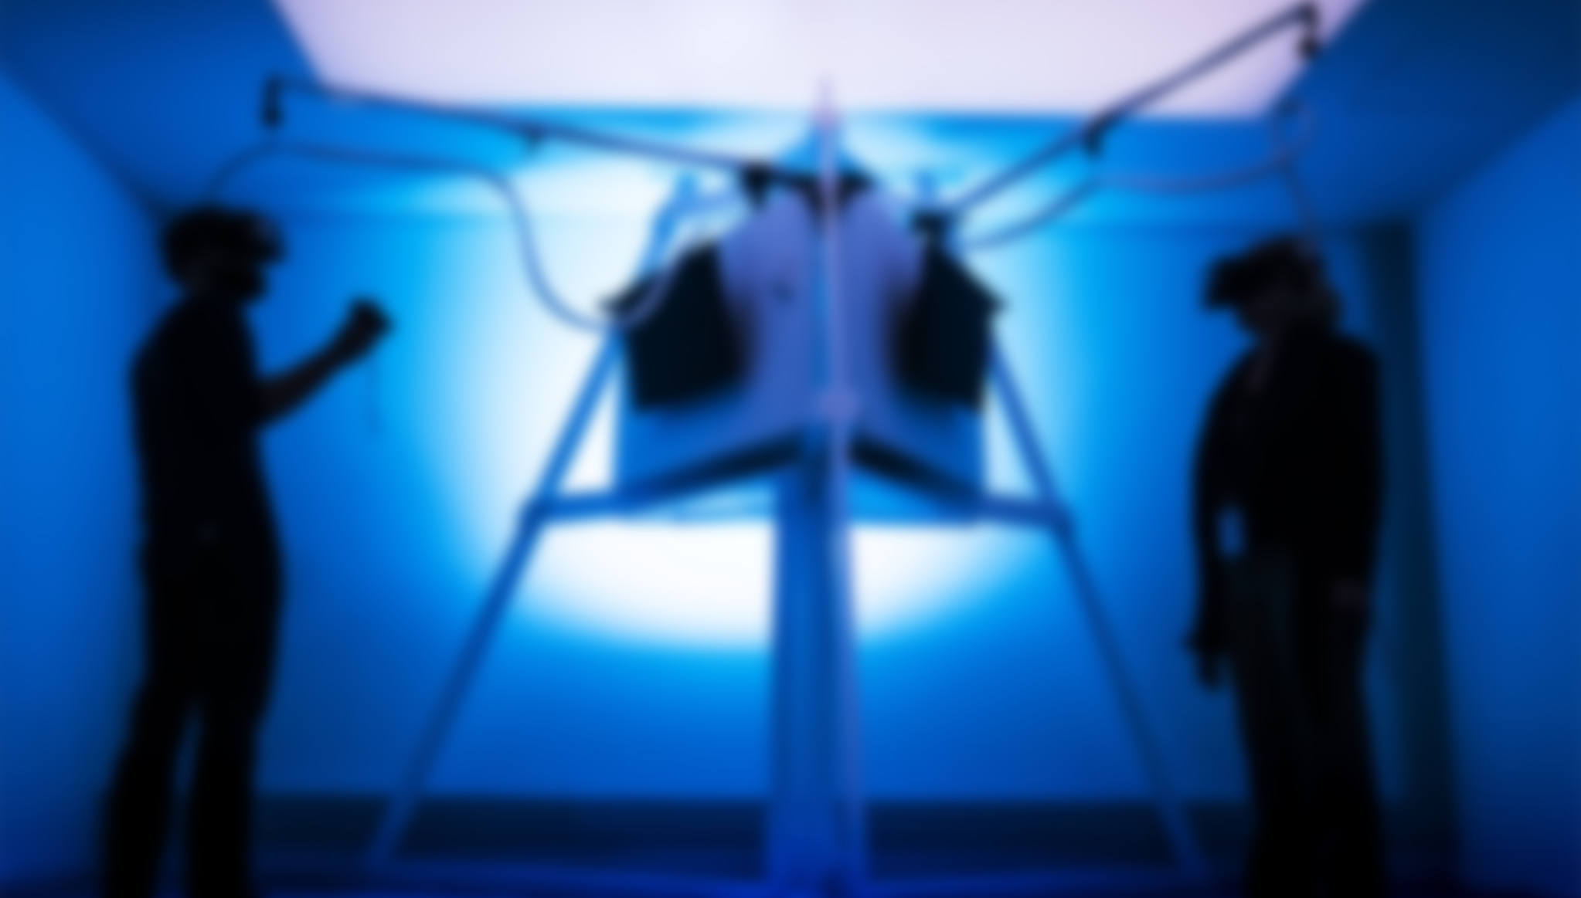
COVID-19
VIRTUALPOLICETRAINING
FUTURE
Virtual Learning when required (pandemic dependent)
Virtualize Career Development learning/training and soft-skills
Re-develop content into modular eLearning opportunities via LMS
Notes:
Preferred method of training is to continue with in-person/in-class training.
Future plans to Virtualize other Career Development type sessions (like our Developing Investigative Skills & Knowledge –DISK- course).

Slide 35
MOVING FORWARD
TECHNOLOGY
1
Familiarity/comfort with technology and delivery models
2
Research innovative tools
TRAINING DELIVERY
3
Completely online courses (virtual classroom and asynchronous learning)
4
Resource management (personnel, technology…etc.)
5
Continuous feedback and adaptability
Notes:
Balance constraints with course design
We know the instructional design is sound, it’s the implementation in the workplace

Slide 36
COVID-19
VIRTUALTRAINING
THANK YOU

