Slide 1

Relationships and Resilience: On the road with a mental health policing unit. Presentation to Stanhope 2020: The New Normal in Policing
Jennifer Ward
Program Manager, Crisis Services
Sept 30, 2020

Slide 2
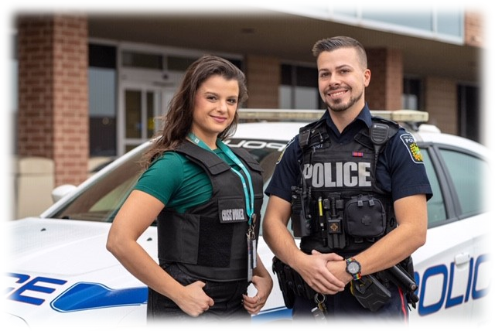
.
In the first two months of the MCRRT launch, the team responded to 373 mental health 911 calls. Nearly half of those calls were referred to our crisis program for follow up support, thereby avoiding a mental health apprehension and diverting from hospital emergency department
.
Notes:
Support ppl with MH and Add in region of PD.
Tell you about who we are, how you can connect with us and some of the most pressing issues we see affect youth today.

Slide 3
Why do we need MCRRT?
Crisis Lin
Mental Health Apprehensions by Peel Police:
We know that police are often the first point of contact with individuals experiencing mental health and addiction issues
2017 5866
2018 6000+
2019 6500
911 Call

Slide 4
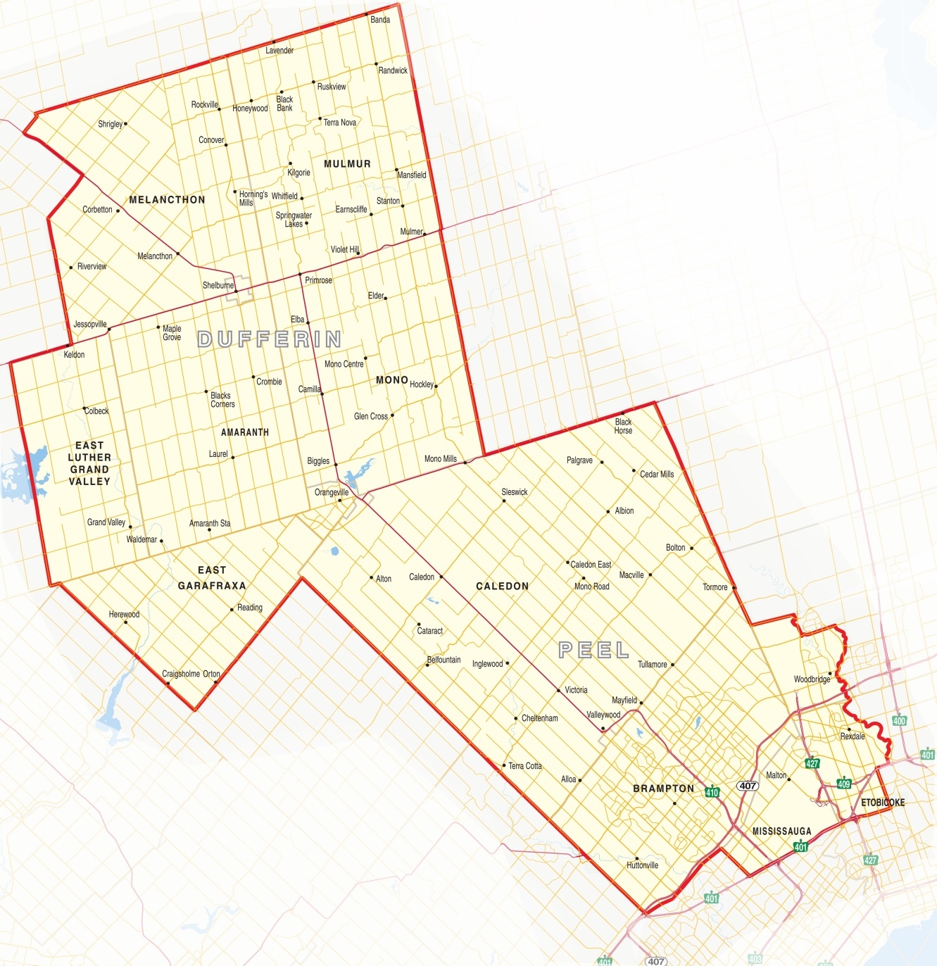
We Support Five Police Services
Dufferin OPP
Shelburne Police Services
Orangeville Police Services
Caledon OPP
York Regional Police Services
Peel
Regional
Police
Toronto Police Services

Slide 5

We Attend Five Hospitals
Trillium Health Partners: Credit Valley Hospital
Mississauga Hospital
William Osler Health Services:
Brampton Civic Hospital
Etobicoke General Hospital
Headwaters Hospital

Slide 6

The 24.7 CSPD “Team”
Our Integrated Team of Registered Professionals:
1 Director
2 Managers
2 FT Crisis Leads
34 FT Crisis Support Workers
9 PT Relief Crisis Support Workers
4 FT Peel Regional Police Officers
1 FT Ontario Provincial Police Officers
A pool of PRP Officers for COAST and MCRRT
1 Behavioural Supports Ontario Nurse
2 FT Program Administrative Assistants
Notes:
*Interdisciplinary team
*Interpretation services
It’s a INTEGRATED TEAM for maximum flexibility & responsiveness
Comprised of Registered Health Professionals
Social Work, Nursing and Occupational Therapy
Experienced clinicians with multiple specialties

Slide 7
Looking for the perfect “fit” / HR Logistics
To expand our existing crisis team we added 19 positions.
Posted role late Sept 2019
2 Job fairs
847 Applicants
92 phone interviews
65 in person interviews
19 offers accepted
Training- Nov/ Dec/ Jan
MCRRT Program Launch January 13, 2020

Slide 8
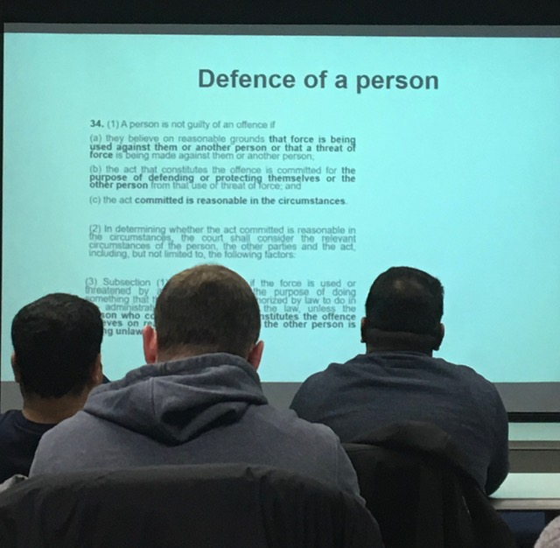
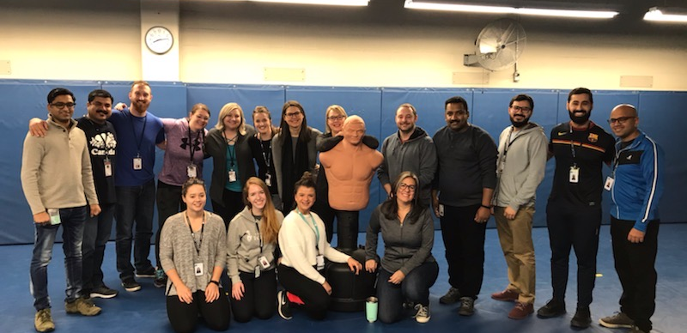
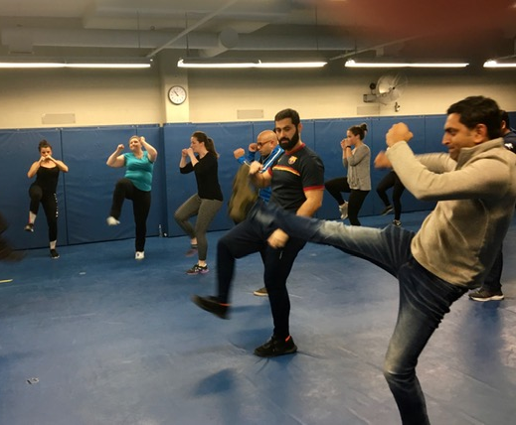
The “Gold Standard” of Training

Slide 9
Curriculum –AKA -Opportunities to understand each other….
5 days ( + 1 month for clinical bootcamp)
Hx of MCRRT programs
SIU
TAC…..and more TAC…..and still talking with TAC
Forensics (please don’t touch that. Or that)
Mental Health Legislation
Privacy and PHI restrictions
Vicarious trauma, sliming and compassion fatigue
Opportunities to understand each other….

Slide 10
A crash course in police and crisis culture
Scenario based learning
Standing vs. sitting
Tone of voice
Open Ended Questions
Taking it slow…..
A demonstration : “this is what it might look like”
Dual role debrief – Safety and clinical combined

Slide 11
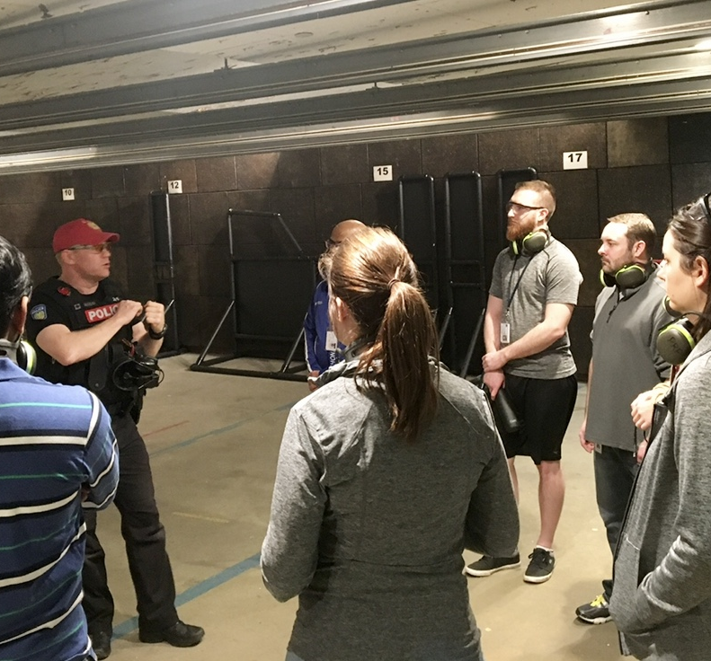
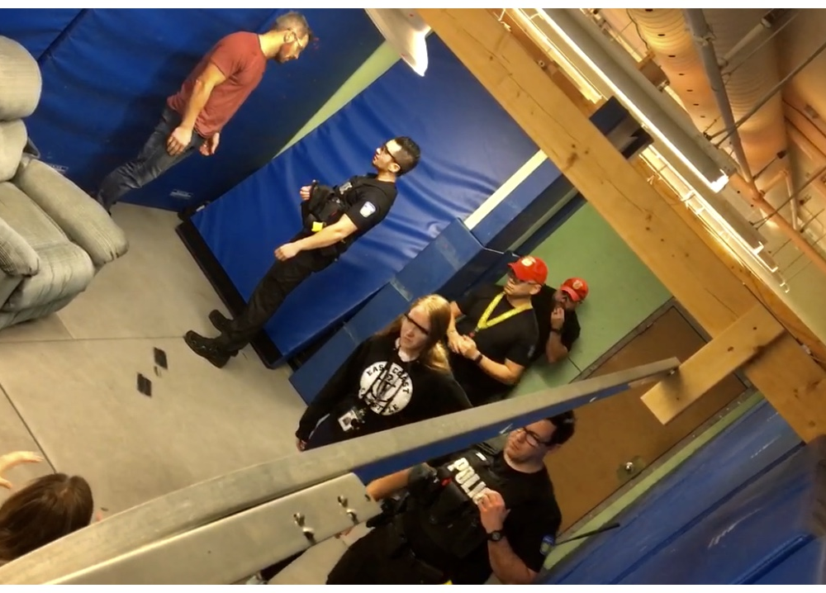
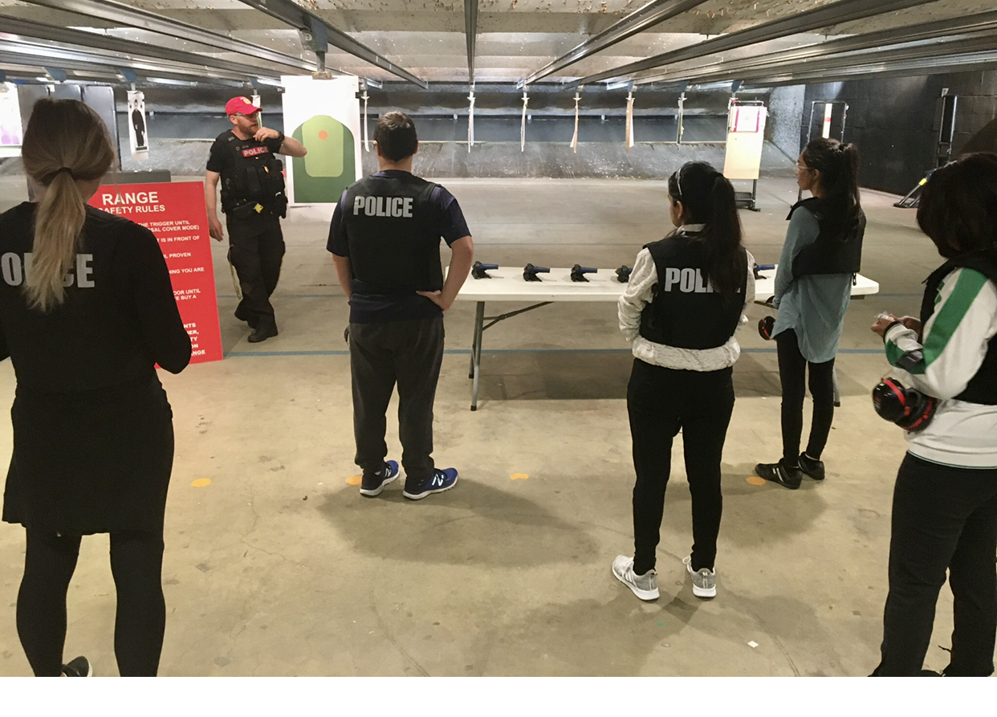

Slide 12
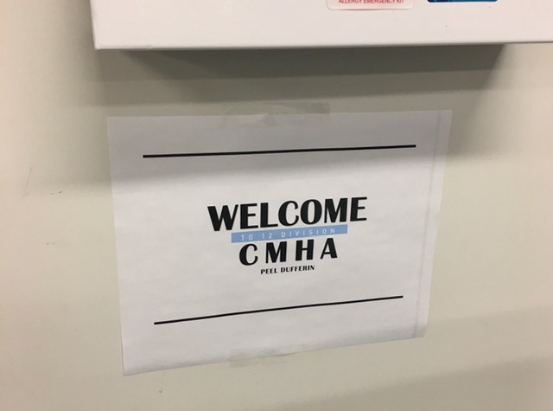
Relationship: A State of being connected
“ Its kind of like dating”
Just a sign on the wall
Tell me what you need – no mind readers here
“when we arrive on scene……”

Slide 13
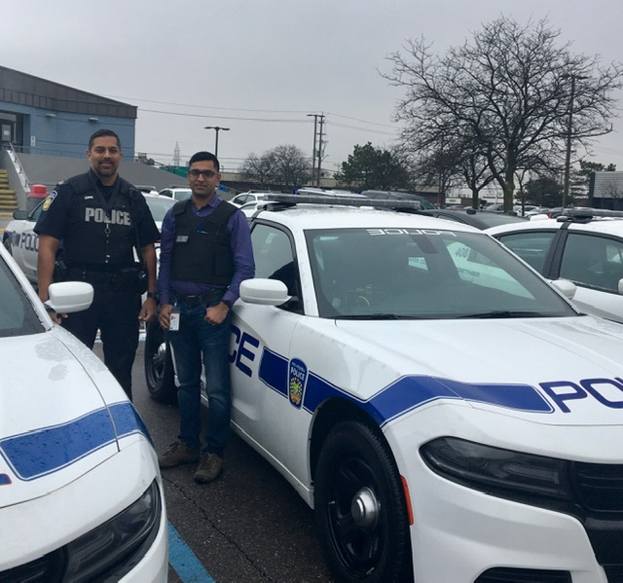
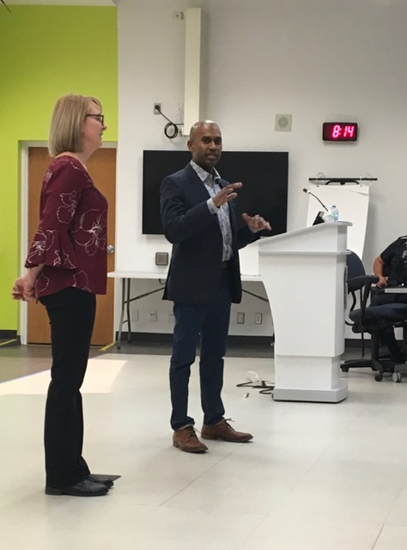
In the Clouds and In the Weeds….
The Leaders and the Do-ers
Work with communications
Advisory, Operations and Steering
Officer, Comms and CSW feedback Survey
Tell me what you need – no mind readers here
“when we arrive on scene……”

Slide 14
MCRRT Q1 Officer Feedback Number of responses received: 16
Q# | Question | Response # | Response
9 | What do you think is working well with the MCRRT program? | 9.1. | Crisis workers are essential resource to provide police with additional referral agencies.
 |  | 9.2. | Connections being made to members of the public
 |  | 9.3. | It is great to have a team that combines the crisis worker with uniform police. I have done many shifts with various workers and have noticed that the publics perspective of the team is welcoming and much better then two officers. it bridges the gap needed in the community to tackle the stigma around mental illness and also just having a crisis worker there with you de escalates a situation that may be escalated solely by police presence. I enjoy doing the shifts and I enjoy helping people in crisis with the support of peel crisis. however one thing to note is that dealing with people in crisis for two 12 hour shifts in a row is mentally exhausting and it requires a certain type of personality to not get affected by it.
 |  | 9.4. | Hospital diversion. Less trauma for the client.
 |  | 9.5. | Number of apprehensions down, knowledge of mental health up.
 |  | 9.6. | The MCRRT program can be inserted into numerous other calls other than mental health specific calls. Ex. I have utilized MR in verbal domestics to provide individuals with alternatives to reach out instead of calling police.
 |  | 9.7. | FACE TO FACE TIME WITH PEOPLE IN CRISIS, SEEING CRISIS WORKERS INSEAD OF JUST POLICE. BEING ABLE TO SPEND NECESSARY TIME WITH PERSONS IN CRISIS INSTEAD OF CLEARING THE CALL ASAP AND RUSHING OUT TO THE NEXT CALL FOR SERVICE. BEING ABLE TO PROVIDE OTHER SERVICES TO ASSIST THE PERSON IN CRISIS.
 |  | 9.8. | Able to assist more people in the community with mental health concerns
 |  | 9.9. | the amount of time dedicated to the person in crisis is very important. As the MCRRT unit we are able to spend a little more time with the person in need, compared to a regular patrol officer that is pressured by the constant calls to calls they must attend
 |  | 9.10. | Effective needs more solid guidelines/directives and more units.
 |  | 9.11. | communication between patient and worker, officer gaining experience from workers
 |  | 9.12. | I think that having a crisis worker with us is helpful for the family or complainant. I think it is important that the caller or family knows there is support after the police arrive and that they are not being left without assistance (if they want it) after a call for service. For example an apprehension. As an officer I feel more comfortable leaving a residence knowing there will be support if the person or individuals would like it. I have seen individuals react differently because a crisis worker has arrived with the police and I believe this is helping in creating a better connection between individuals in the community experiencing difficulty with mental health, CMHA and the police.

Slide 15
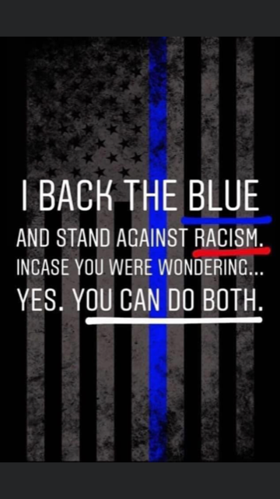
“We wanted you to know….”
…..have had a lot of important and difficult conversations with our team members in the past weeks regarding the current climate, Black Lives Matters, Public perceptions on Police Services, our partnership, program and many other related matters. This past Tuesday evening our entire Team meeting was spent sharing our ideas, experiences and opinions.
We felt it was important to share with you that our leadership and our crisis support workers all remain incredibly proud of the work we do alongside you, our police partners. Individually, and as a team we also stand against anti-black racism, racism; and importantly, we feel we can do that and simultaneously support police.
We believe that relationships , partnerships and programs like ours are an important part of the way forward.
We thank you for your service.

Slide 16






260 days later…Peel MCRRT Statistics so far…
Crisis Lin
1463 calls
321 apprehensions (22%)
81 individuals under 16 (6%)
702 referrals to 24.7 Crisis program (48%)
8 Form 47s
15 Form 2s
911 Call

Slide 17






Benefits of MCRRT
Bring expertise of Crisis Worker to the individual within minutes
Divert from the ED to the appropriate resources
Redirect police back to other police work
On-road resource to police
Increased use of 24/7 Crisis to support individuals and prevent future crises
Replicated in Niagara, Halton, Norfolk Brantford, Haldimand and now PEEL!
Crisis Lin
911 Call

Slide 18
Client Feedback
“I wanted to reach out and say a big thank you to the worker and officers that responded to our crisis yesterday. I was the person in crisis and my wife contacted the response unit. They were very professional, friendly and understanding. They came into the situation with no assumptions or preconceived notions and took the time to talk and understand what was happening. If there is a record of the officers and worker that responded, please extend our sincere gratitude and appreciation to them and let them know that we are good and will get through it. Regardless of everything in the media right now, you (police officers and crisis workers) are all needed and matter to people like me and my family.”

Slide 19
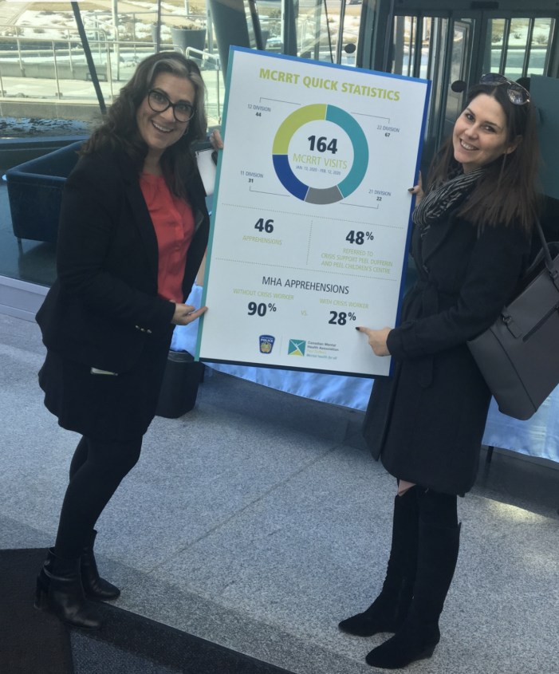
Crisis Lin
Any Questions?
wardj@cmhapeel.ca

